Slide 1

Sales Insight
Customer Behavior
Presented by Saraijah Porth

Slide 2

Introduction
This project analyzes customer purchasing patterns to identify trends in spending behavior. The focus is on understanding how factors like product preferences and transaction sizes influence overall sales.
These insights are valuable for businesses looking to optimize marketing strategies and improve sales performance. The dataset, sourced from Kaggle, contains transaction details and sales data, allowing for a detailed exploration of shopping trends.

Slide 3
Data and Methodologies
For this analysis, we utilize a simulated dataset from Kaggle.com that replicates real-world customer transactions. Our objective is to analyze spending behaviors and uncover key influencing factors, including age, gender, and product preferences. By identifying these patterns, we can gain valuable insights into consumer purchasing trends, which can help businesses optimize marketing strategies and enhance customer engagement.

Slide 4
Dataset Overview
Transaction ID: A unique identifier for each transaction.
Customer ID – A unique identifier for each customer.
Date – The date when the transaction took place.
Gender – The gender of the customer.
Age – The customer's age at the time of the purchase.
Product Category – The category of the product purchased.
Quantity – The number of units purchased in each transaction.
Price per Unit – The cost of a single unit of the product.
Total Amount – The total cost of the transaction (calculated as Quantity × Price per Unit).
The dataset provides enough information to analyze purchasing patterns and determine which factors influence consumer behavior the most.

Slide 5
Objectives
How does customer age and gender influence their purchasing behavior?
Are there discernible patterns in sales across different time periods?
Which product categories hold the highest appeal among customers?
What are the relationships between age, spending, and product preferences?
How do customers adapt their shopping habits during seasonal trends?
Are there distinct purchasing behaviors based on the number of items bought per transaction?
What insights can be gleaned from the distribution of product prices within each category?

Slide 6

How does customer age and gender influence their purchasing behavior?
01

Slide 7

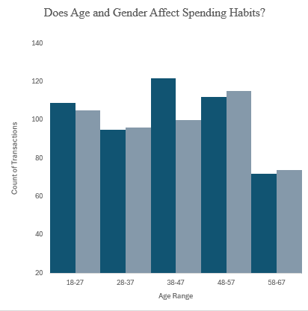
Key Insights
Males 48-57spend the most per item.
Women 38-47 spend more on quality products.
Males and females 58-67 spend the least.

Slide 8

Why does this Happen?
Males (48-57) Spend the Most Per Item
Women (38-47) Spend More on Shopping
Males & Females (58-67) Spend the Least
At this stage, many are in peak career years, earning higher salaries.
Increased disposable income allows for premium purchases
More digital shopping habits and exposure to targeted advertising.
Tend to focus on quality over quantity, purchasing higher-end products.
Increased self-care spending on beauty, fashion, and wellness.
Financial stability leads to more discretionary spending.
Many are retired or approaching retirement as a result less disposable income.
Relying on pensions, savings, or social security, leading to budget-conscious shopping.
Prioritizing necessities over luxury items.

Slide 9

Actionable Steps
1. Loyalty programs
2. Personalized marketing
Exclusive deals for high spenders
Target ads based on age & spending habits.
3. Flexible payment options
4. Improved digital shopping
Installments for older shoppers
Tailored recommendations & easy navigation

Slide 10

Sales Data Across Time Periods
02

Slide 11
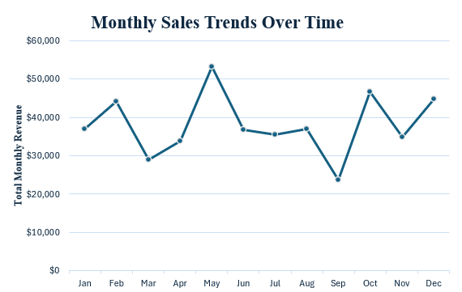
Key Insights
Peak in May: Sales spiked to $53,150, the highest in the year.
Lowest in September: Sales dropped significantly to $23,620, marking the lowest point.

Slide 12


Why does this Happen?
Summer and Vacation Season
Back-to-School Season and Post-Summer Slowdown
The May peak aligns with the start of summer, when people prepare for vacations, purchase gifts, clothing, beauty products, and personal items for themselves and their families. It’s a time of high consumer activity, especially in clothing and beauty.
The September drop coincides with the end of summer, when people may return to work or school, leading to a decrease in discretionary spending. After summer vacations, there might be less focus on personal shopping.

Slide 13
Actionable Steps
Capitalize on Summer Spending
Boost Engagement During Slow Months
Consider offering loyalty rewards or exclusive deals in September to re-engage customers who are coming back from the summer and may need back-to-school or fall-related products..
Run targeted promotions and discounts in May to attract customers preparing for vacations and seeking summer-related items such as clothing and beauty products.
Flexible payment options
Leverage data to plan future campaigns around other key seasons, like the holiday period, to maintain consistent sales throughout the year

Slide 14
Conclusion
Our analysis reveals distinct spending patterns across age groups and seasonal trends. Males aged 48-57 exhibit the highest spending, likely due to greater disposable income, whereas individuals aged 58-67 tend to be more cautious, possibly due to retirement or financial planning. Additionally, sales peak during the summer months, driven by vacations, school breaks, and seasonal shopping demands.
These insights underscore the importance of aligning business strategies with consumer behavior. By optimizing marketing campaigns, personalized promotions, and inventory planning based on these trends, businesses can enhance customer engagement and drive revenue growth.
.

Slide 15
References
Talib, M. (n.d.). Retail Sales Dataset. Kaggle. Retrieved March 26, 2025, from https://www.kaggle.com/datasets/mohammadtalib786/retail-sales-dataset

Slide 16

Thank You

